Slide 1
MEASUREMENT
Yr 12 Essentials
Chapter 1

Slide 2
Contents
Formula Page
Page
Date
Description
2
3

Slide 3
Tasks
24
7
30
Essential Question
Questions
Notes
Summary
4
5

Slide 4
24
7
30
Date
Units of length
EQ – How do I covert between metric units of length?
5

Slide 5
24
7
30
Date
Units of length
EQ – How do I covert between metric units of length?
Converting Units
Converting Units
km m cm mm
km m cm mm
5

Slide 6
24
7
30
Date
Units of length
EQ – How do I covert between metric units of length?
Converting Units
Converting Units
km m cm mm
km m cm mm
5

Slide 7
24
7
30
Date
Units of length
EQ – How do I covert between metric units of length?
Converting Units
Converting Units
km m cm mm
km m cm mm
5

Slide 8
24
7
30
Date
Units of length
EQ – How do I covert between metric units of length?
Converting Units
Converting Units
km m cm mm
km m cm mm
5

Slide 9
24
7
30
Date
Units of length
EQ – How do I covert between metric units of length?
Converting Units
Converting Units
x1000
km m cm mm
km m cm mm
5

Slide 10
24
7
30
Date
Units of length
EQ – How do I covert between metric units of length?
Converting Units
Converting Units
x1000 x 100
km m cm mm
km m cm mm
5

Slide 11
24
7
30
Date
Units of length
EQ – How do I covert between metric units of length?
Converting Units
Converting Units
x1000 x 100 x10
km m cm mm
km m cm mm
5

Slide 12
24
7
30
Date
Units of length
EQ – How do I covert between metric units of length?
Converting Units
Converting Units
x1000 x 100 x10
km m cm mm
km m cm mm
5

Slide 13
24
7
30
Date
Units of length
EQ – How do I covert between metric units of length?
Converting Units
Converting Units
x1000 x 100 x10
km m cm mm
km m cm mm
5

Slide 14
24
7
30
Date
Units of length
EQ – How do I covert between metric units of length?
Converting Units
Converting Units
x1000 x 100 x10
km m cm mm
km m cm mm
5

Slide 15

24
7
30
Date
Units of length
EQ – How do I covert between metric units of length?
Converting Units
Converting Units
x1000 x 100 x10
km m cm mm
km m cm mm
$÷$1000
5

Slide 16

24
7
30
Date
Units of length
EQ – How do I covert between metric units of length?
Converting Units
Converting Units
x1000 x 100 x10
km m cm mm
km m cm mm
$÷$1000 $÷$100
5

Slide 17

24
7
30
Date
Units of length
EQ – How do I covert between metric units of length?
Converting Units
Converting Units
x1000 x 100 x10
km m cm mm
km m cm mm
$÷$1000 $÷$100 $÷$10
5

Slide 18
24
7
30
Date
Units of length
EQ – How do I covert between metric units of length?
Converting Units
Converting Units
x1000 x 100 x10
km m cm mm
km m cm mm
$÷$1000 $÷$100 $÷$10
Change the following to the given units
5m to cm
780mm to cm
2.4km to cm
5

Slide 19
24
7
30
Date
Units of length
EQ – How do I covert between metric units of length?
Converting Units
Converting Units
x1000 x 100 x10
km m cm mm
km m cm mm
$÷$1000 $÷$100 $÷$10
Change the following to the given units
5m to cm
780mm to cm
2.4km to cm
5

Slide 20
24
7
30
Date
Units of length
EQ – How do I covert between metric units of length?
Converting Units
Converting Units
x1000 x 100 x10
km m cm mm
km m cm mm
$÷$1000 $÷$100 $÷$10
Change the following to the given units
5m to cm 5 x100 = 500cm
780mm to cm
2.4km to cm
5

Slide 21
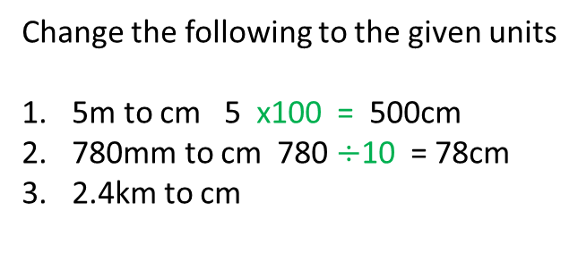
24
7
30
Date
Units of length
EQ – How do I covert between metric units of length?
Converting Units
Converting Units
x1000 x 100 x10
km m cm mm
km m cm mm
$÷$1000 $÷$100 $÷$10
Change the following to the given units
5m to cm 5 x100 = 500cm
780mm to cm 780 $÷$10 = 78cm
2.4km to cm
5

Slide 22
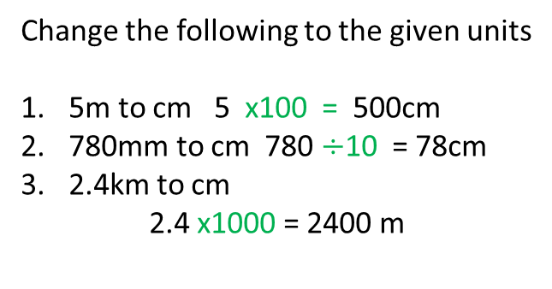
24
7
30
Date
Units of length
EQ – How do I covert between metric units of length?
Converting Units
Converting Units
x1000 x 100 x10
km m cm mm
km m cm mm
$÷$1000 $÷$100 $÷$10
Change the following to the given units
5m to cm 5 x100 = 500cm
780mm to cm 780 $÷$10 = 78cm
2.4km to cm
2.4 x1000 = 2400 m
5

Slide 23
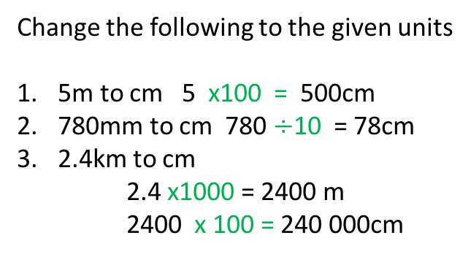
24
7
30
Date
Units of length
EQ – How do I covert between metric units of length?
Converting Units
Converting Units
x1000 x 100 x10
km m cm mm
km m cm mm
$÷$1000 $÷$100 $÷$10
Change the following to the given units
5m to cm 5 x100 = 500cm
780mm to cm 780 $÷$10 = 78cm
2.4km to cm
2.4 x1000 = 2400 m
2400 x 100 = 240 000cm
5

Slide 24
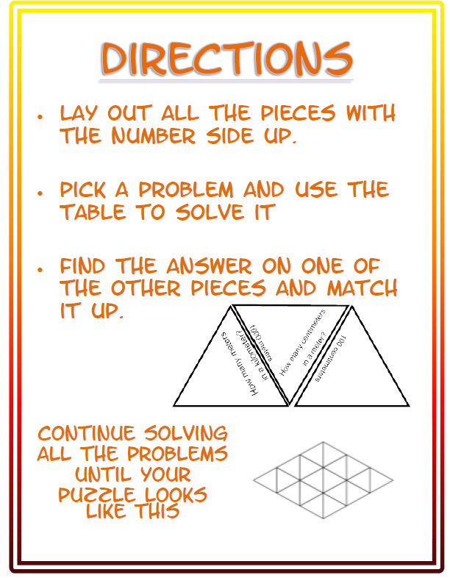
Guided Practice
Converting Units worksheet
Metric Length puzzle

